Slide 1
B2B Guest Accounts
Community Days at Sea
Notes:
1
1

Slide 2
B2B Guest Accounts
Entra ID Magic

Slide 3
Prerequisites for the scenario
User principal name and primary email address are not identical
Example UPN
P1234@upn.logondomain.net
Primary email address
John.Doe@varunagroup.de

Slide 4
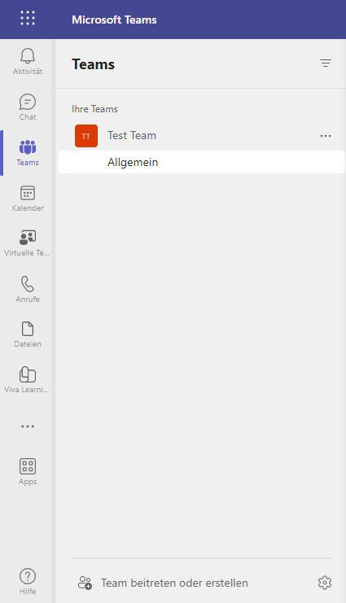
B2B Use-Case
Varuna Group – Source Tenant
Ixion – Inviting Tenant
Primary SMTP address John.Doe@varunagroup.de
John is to work in a team at Ixion

Slide 5
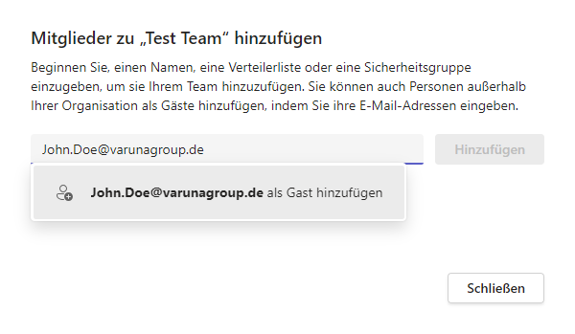
B2B Use-Case
Varuna Group – Source Tenant
Ixion – Inviting Tenant
Primary SMTP address John.Doe@varunagroup.de
John Doe receives an invite by email

Slide 6
What happens technically?
Entra ID Invites

Slide 7
B2B Account – Step 1
Primary email address and user principal name are identical
John Doe receives an invite by email
Varuna Group – Source Tenant
Ixion – Inviting Tenant
Company Account
Primary SMTP Address John.Doe@varunagroup.de
B2B Guest Account (Entra ID) MailGuestUser Object (EXO)
EmailAddress SMTP:John.Doe@varunagroup.de
SignInName
John.Doe@varunagroup.de
UserPrincipalName John.Doe_varunagroup.de#EXT#ixion.de MailNickName John.Doe_varunagroup.de#EXT#
B2B Invite
Invite to John.Doe@varunagroup.de
Entra ID creates a new B2B guest account using the email address as
Name
SignInName
User Principal Name
Exchange Online Directory Services creates a mail user object

Slide 8
B2B Account – Step 2
Primary email address and user principal name are identical
John Doe accepts invite
Varuna Group – Source Tenant
Ixion – Inviting Tenant
Company Account
Primary SMTP Address John.Doe@varunagroup.de
B2B Guest Account (Entra ID) MailGuestUser Object (EXO)
EmailAddress SMTP:John.Doe@varunagroup.de
SignInName
John.Doe@varunagroup.de
UserPrincipalName John.Doe_varunagroup.de#EXT#ixion.de MailNickName John.Doe_varunagroup.de#EXT#
B2B Invite
User accepts the invite and logs on to the inviting tenant.
Entra ID queries for permission to read profile information for
Name

Slide 9
So far so good But what happens if primary email address and user principal name are not identical?

Slide 10
B2B Account – Step 1
Primary email address and user principal name are not identical
John Doe receives an invite by email
Varuna Group – Source Tenant
Ixion – Inviting Tenant
Company Account
User Principal Name P1234@emea.logondomain.net
Primary SMTP Address John.Doe@varunagroup.de
B2B Guest Account (Entra ID) MailGuestUser Object (EXO)
EmailAddress SMTP:John.Doe@varunagroup.de
SignInName
John.Doe@varunagroup.de
UserPrincipalName John.Doe_varunagroup.de#EXT#ixion.de MailNickName John.Doe_varunagroup.de#EXT#
B2B Invite
Invite to John.Doe@varunagroup.de
Entra ID creates a new B2B guest account using the email address as
Name
SignInName
User Principal Name
Exchange Online Directory Services creates a mail user object

Slide 11
B2B Account – Step 2
Primary email address and user principal name are not identical
John Doe accepts invite
Varuna Group – Source Tenant
Ixion – Inviting Tenant
Company Account
User Principal Name P1234@emea.logondomain.net
Primary SMTP Address John.Doe@varunagroup.de
B2B Guest Account (Entra ID) MailGuestUser Object (EXO)
EmailAddress SMTP:John.Doe@varunagroup.de
SignInName
P1234@emea.logondomain.net
UserPrincipalName P1234_emea.logondomain.net#EXT#ixion.de MailNickName P1234_emea.logondomain.net #EXT#
B2B Invite
User accepts the invite and logs on to the inviting tenant.
Entra ID queries for permission to read profile information and updates the B2B guest account

Slide 12
Email Flow
Primary email address as of original invite
Email to John Doe
Varuna Group – Source Tenant
Ixion – Inviting Tenant
Company Account
User Principal Name P1234@emea.logondomain.net
Primary SMTP Address John.Doe@varunagroup.de
B2B Guest Account (Entra ID) MailGuestUser Object (EXO)
EmailAddress SMTP:John.Doe@varunagroup.de
MailNickName P1234_emea.logondomain.net #EXT#
Ixion user sends email
Exchange Online resolves the recipient address to the existing mail user object of varunagroup.de and delivers the email to Varuna Group's mail server.
Receiving address John.Doe@varunagroup.de
EXO resolves to John.Doe@varunagroup.de
Email to John.Doe@varunagroup.de

Slide 13
Where The Fun Begins
Merger and Acquisition
or
Carve Out

Slide 14
B2B Account – Domain Change – Step 1
New primary email address and user principal name are not identical
Varuna Group – Source Tenant
Ixion – Inviting Tenant
Company Account
User Principal Name P1234@emea.logondomain.net
Primary SMTP Address JDoe@setebos-ag.com
Secondary SMTP Address John.Doe@varunagroup.de
B2B Guest Account (Entra ID) MailGuestUser Object (EXO)
EmailAddress SMTP:JDoe@setebos-ag.com
SignInName
JDoe@setebos-ag.com
UserPrincipalName JDoe_Setebos-ag.com#EXT#ixion.de MailNickName JDoe_Setebos-ag.com#EXT#
Primary SMTP Address change
Varuna Group changes the company name and updates primary SMTP addresses to the new domain
setebos-ag.com

Slide 15
B2B Account – Domain Change – Step 2
New primary email address and user principal name are not identical
John Doe receives an invite by email
Varuna Group – Source Tenant
Ixion – Inviting Tenant
Company Account
User Principal Name P1234@emea.logondomain.net
Primary SMTP Address JDoe@setebos-ag.com
Secondary SMTP Address John.Doe@varunagroup.de
B2B Guest Account (Entra ID) MailGuestUser Object (EXO)
EmailAddress SMTP:John.Doe@
SignInName
John.Doe@varunagroup.de
UserPrincipalName John.Doe_varunagroup.de#EXT#ixion.de MailNickName John.Doe_varunagroup.de#EXT#
B2B Invite to new address
Invite to JDoe@setebos-ag.com
Entra ID creates a new B2B guest account using the email address as
Name
SignInName
User Principal Name
Exchange Online Directory Services creates a mail user object

Slide 16
B2B Account – Domain Change – Step 3
New primary email address and user principal name are not identical
John Doe logs on to the new Team
Varuna Group – Source Tenant
Ixion – Inviting Tenant
Company Account
User Principal Name P1234@emea.logondomain.net
Primary SMTP Address JDoe@setebos-ag.com
Secondary SMTP Address John.Doe@varunagroup.de
B2B Guest Account (Entra ID) MailGuestUser Object (EXO)
EmailAddress SMTP:John.Doe@varunagroup.de
SignInName
P1234@emea.logondomain.net
UserPrincipalName P1234_emea.logondomain.net#EXT#ixion.de MailNickName P1234_emea.logondomain.net #EXT#
B2B Invite
User accepts the invite and logs on to the inviting tenant.
Entra ID queries for permission to read profile information and updates the B2B guest account

Slide 17
B2B Account – Domain Change – Step 4
John Doe accepts invite
Varuna Group – Source Tenant
Ixion – Inviting Tenant
Company Account
User Principal Name P1234@emea.logondomain.net
Primary SMTP Address JDoe@setebos-ag.com
Secondary SMTP Address John.Doe@varunagroup.de
B2B Guest Account (Entra ID) MailGuestUser Object (EXO)
EmailAddress SMTP:John.Doe@varunagroup.de smtp:Jdoe@setebos-ag.com
SignInName
P1234@emea.logondomain.net
UserPrincipalName P1234_emea.logondomain.net#EXT#ixion.de MailNickName P1234_emea.logondomain.net #EXT#
B2B Invite
User accepts the invite and logs on to the inviting tenant.
Entra ID queries for permission to read profile information and updates the existing B2B guest account.
Entra ID merges the two guest accounts with the SignInName as matching criteria.

Slide 18
Email Flow
Primary email address as of original invite
Email to John Doe
Varuna Group – Source Tenant
Ixion – Inviting Tenant
Company Account
User Principal Name P1234@emea.logondomain.net
Primary SMTP Address JDoe@setebos-ag.com
Secondary SMTP Address John.Doe@varunagroup.de
B2B Guest Account (Entra ID) MailGuestUser Object (EXO)
EmailAddress SMTP:John.Doe@varunagroup.de smtp:Jdoe@setebos-ag.com
MailNickName P1234_emea.logondomain.net #EXT#
Ixion user sends email
Exchange Online resolves the recipient address to the existing mail user object of varunagroup.de, updates the recipient address and delivers the email to Varuna Group's mail server.
Receiving address John.Doe@varunagroup.de
EXO resolves to John.Doe@varunagroup.de
Email to JDoe@setebos-ag.com

Slide 19

Email Flow
Primary email address as of original invite
Email to John Doe
Varuna Group – Source Tenant
Ixion – Inviting Tenant
Company Account
User Principal Name P1234@emea.logondomain.net
Primary SMTP Address JDoe@setebos-ag.com
B2B Guest Account (Entra ID) MailGuestUser Object (EXO)
EmailAddress SMTP:John.Doe@varunagroup.de smtp:Jdoe@setebos-ag.com
MailNickName P1234_emea.logondomain.net #EXT#
Varuna Domain Cleanup
Proxy address varunagroup.de deleted
Ixion user sends email
Exchange Online resolves the recipient address to the existing mail user object of varunagroup.de, updates the recipient address and delivers the email to Varuna Group's mail server.
Non-existing address John.Doe@varunagroup.de
EXO resolves and updates to John.Doe@varunagroup.de
Email to JDoe@setebos-ag.com

Slide 20
Summary
The inviting tenant adds email addresses to an existing guest account, if the guest uses a dedicated user principal name as sign in name
Email delivery fails to the original email address of the guest user if the address is removed from the account, e.g., domain renaming, carve-out, etc.
As an inviting party for B2B you must update the B2B guest account manually
If you update email addresses in your tenant, you should information your partners

Slide 21
Questions?
Slides by www.SUBTITLE.com
Notes:
21
21

Slide 22

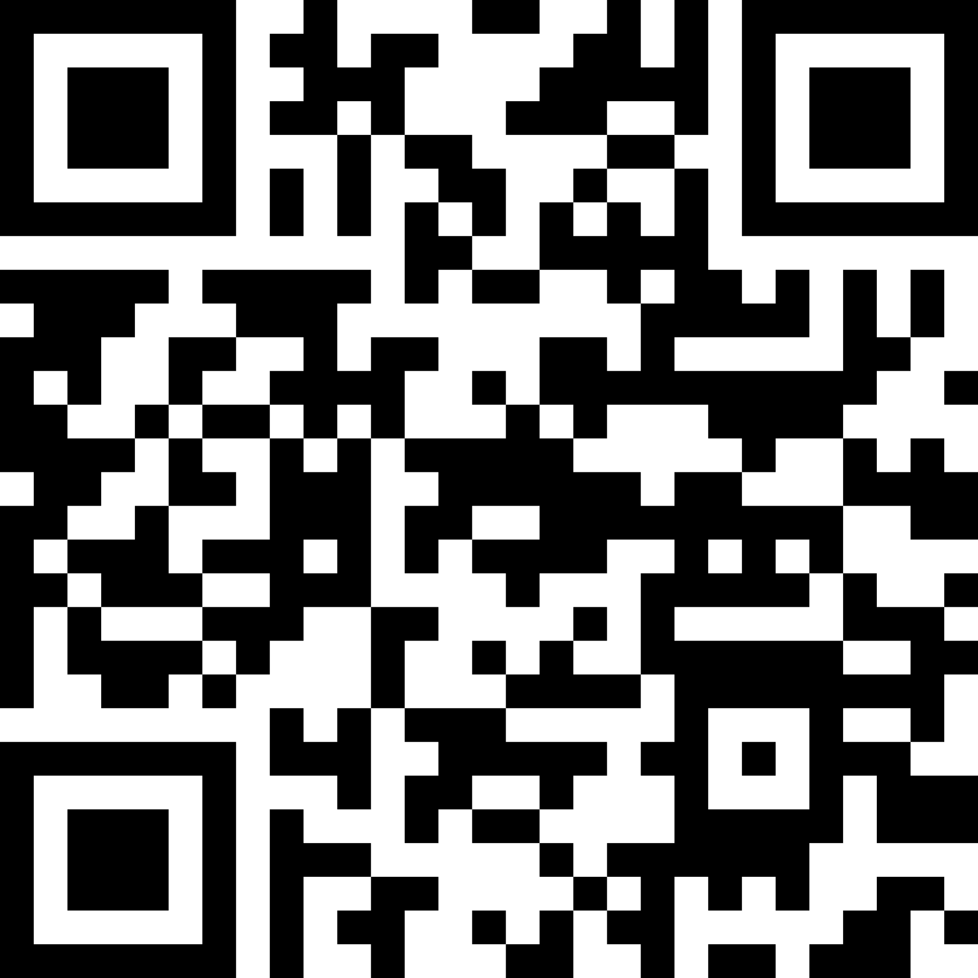
Thomas Stensitzki
Experte Granikos GmbH & Co. KG MVP | MCT | MCSM @stensitzki.bsky.social thomas.stensitzki@granikos.eu
https://linktr.ee/stensitzki

